Slide 1


Important medical fungi
Lecture 10
Prof. Dr. Munira Ch. Ismaeel
Ass. Prof. Dr. Israa AJ Ibrahim

Slide 2

Important medical fungi L.10
Prof. Dr. Munira Ch. Ismaeel and Ass. Prof. Dr. Israa AJ Ibrahim

Slide 3
Fungi as Parasites & Pathogens
A limited number of fungi are pathogenic to humans. Mycoses (sing: mycosis) in humans may be cutaneous, or systemic.
spores generally enter the body by inhalation, but subsequently spread to other organ systems via the blood, causing serious, even fatal disease.
Thousands of fungi both yeasts and filamentous fungi are present in the environment. About 100 of them cause disease in man and animals.
Only very few species like dermatophytes and Candida are transmitted from man to man.
Epidemiology Normal habitat is the environment except Candida albicans is part of normal human flora. Most mycotic agents are soil saprophytes. Mycotic diseases are not contagious except in few cases as in superfacial mycoses. Establishment of infection depends on inoculum size , resistance of the host rather than virulence of fungus.

Slide 4
Mycotic Diseases
- Generally the fungal infections are classified into:
a-superficial mycoses
b-cutaneous mycoses
c-Subcutaneous mycoses
d-systemic mycoses

Slide 5
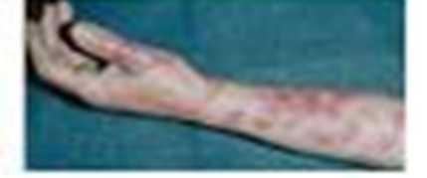
Superficial mycoses
most often used Superficial - Confined to the outer most layers of the skin and hair. No host cellular or inflammatory response.
Cutaneous - in the keratin of the skin, nails, and hair.
These organisms prefer non-living cornified layers. The disease is called a dermatophytosis or dermatomycosis.
Host response is patchy scaling or eczema eruptions

Slide 6
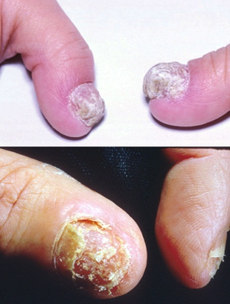
Cutaneous mycoses
Cutaneous mycoses are the most common fungal infections found in humans, and are caused by fungi known as dermatophytes, which are able to utilise the keratin of skin, hair or nails by secreting the enzyme keratinase. Popular names for such infections include ringworm and athletes’ foot. They are highly contagious, but not usually serious conditions.

Slide 7
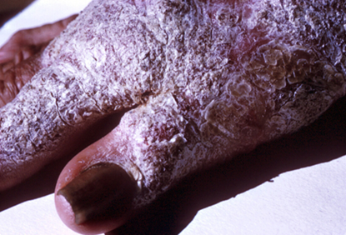
Subcutaneous mycoses
Subcutaneous - Involve the deeper layers of skin and often muscle tissue. Man is an accidental host following inoculation of fungal spores via some form of trauma. This type of infection is often identified by the presence of a characteristic tissue reaction or granule.

Slide 8
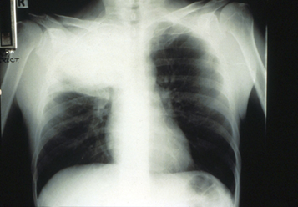
Systemic disease
Those caused by truly pathogenic fungi with the ability to cause disease in the normal human host when the inoculum is of sufficient size (Histoplasma capsulatum, Blastomyces dermatitidis, Coccidioides immitis, Paracoccidioides braziliensis).
-Those caused by opportunistic fungi, low virulence organisms, which require the patient's defenses to be lowered before the infection is established (Aspergillus spp. Candida albicans, Cryptococcus neoformans).
Pulmonary Cryptococcosis

Slide 9
Mycotoxins
Mycotoxins; Many fungi produce natural mycotoxins; these are secondary metabolites, which, if consumed by humans, can cause food poisoning that can sometimes be fatal.
Certain species of mushrooms (‘toadstools’) including the genus Amanita contain substances that are highly poisonous to humans. Other examples of mycotoxin illnesses include ergotism and aflatoxin poisoning.
Aflatoxins are carcinogenic toxins produced by Aspergillus flavus that grows on stored peanuts. In the early 1960s, the turkey industry in the UK was almost crippled by ‘Turkey X disease’, caused by the consumption
of feed contaminated by A. flavus.

